Slide 1

Introducing MVC architecture and Spring MVC

Slide 2

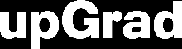
Course : Backend
Lecture On : Introducing MVC architecture and Spring MVC
Instructor :

Slide 3
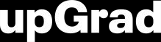
Today’s Agenda
Introduction to MVC architecture
Spring MVC
SpringBoot
HelloWorld using Spring MVC

Slide 4
Introduction to MVC architecture
One of the major drawbacks of developing a web application using servlet/JSP is the separation of concerns.
MVC or the Model-View-Controller aims to solve exactly this problem.

Slide 5
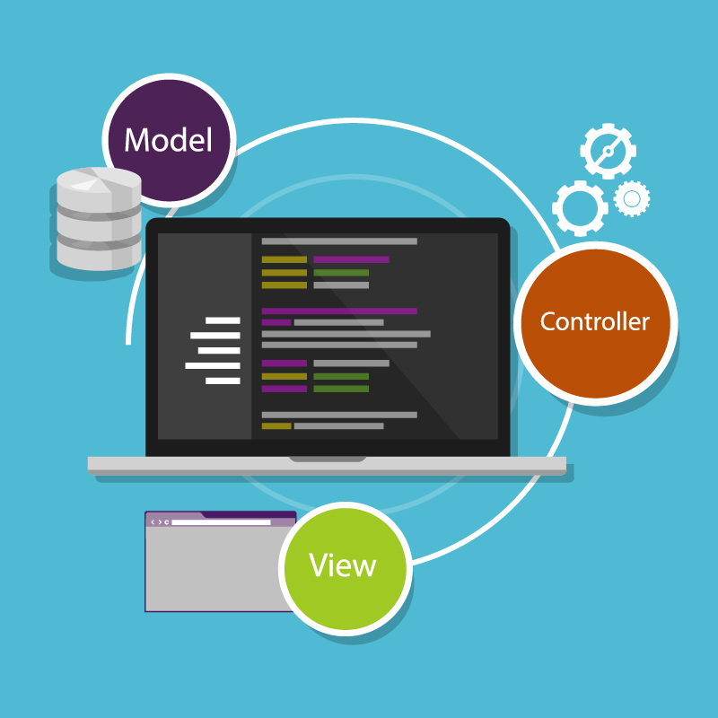
Introduction to MVC architecture
MVC separates an application into three component:
Model
View
Controller

Slide 6
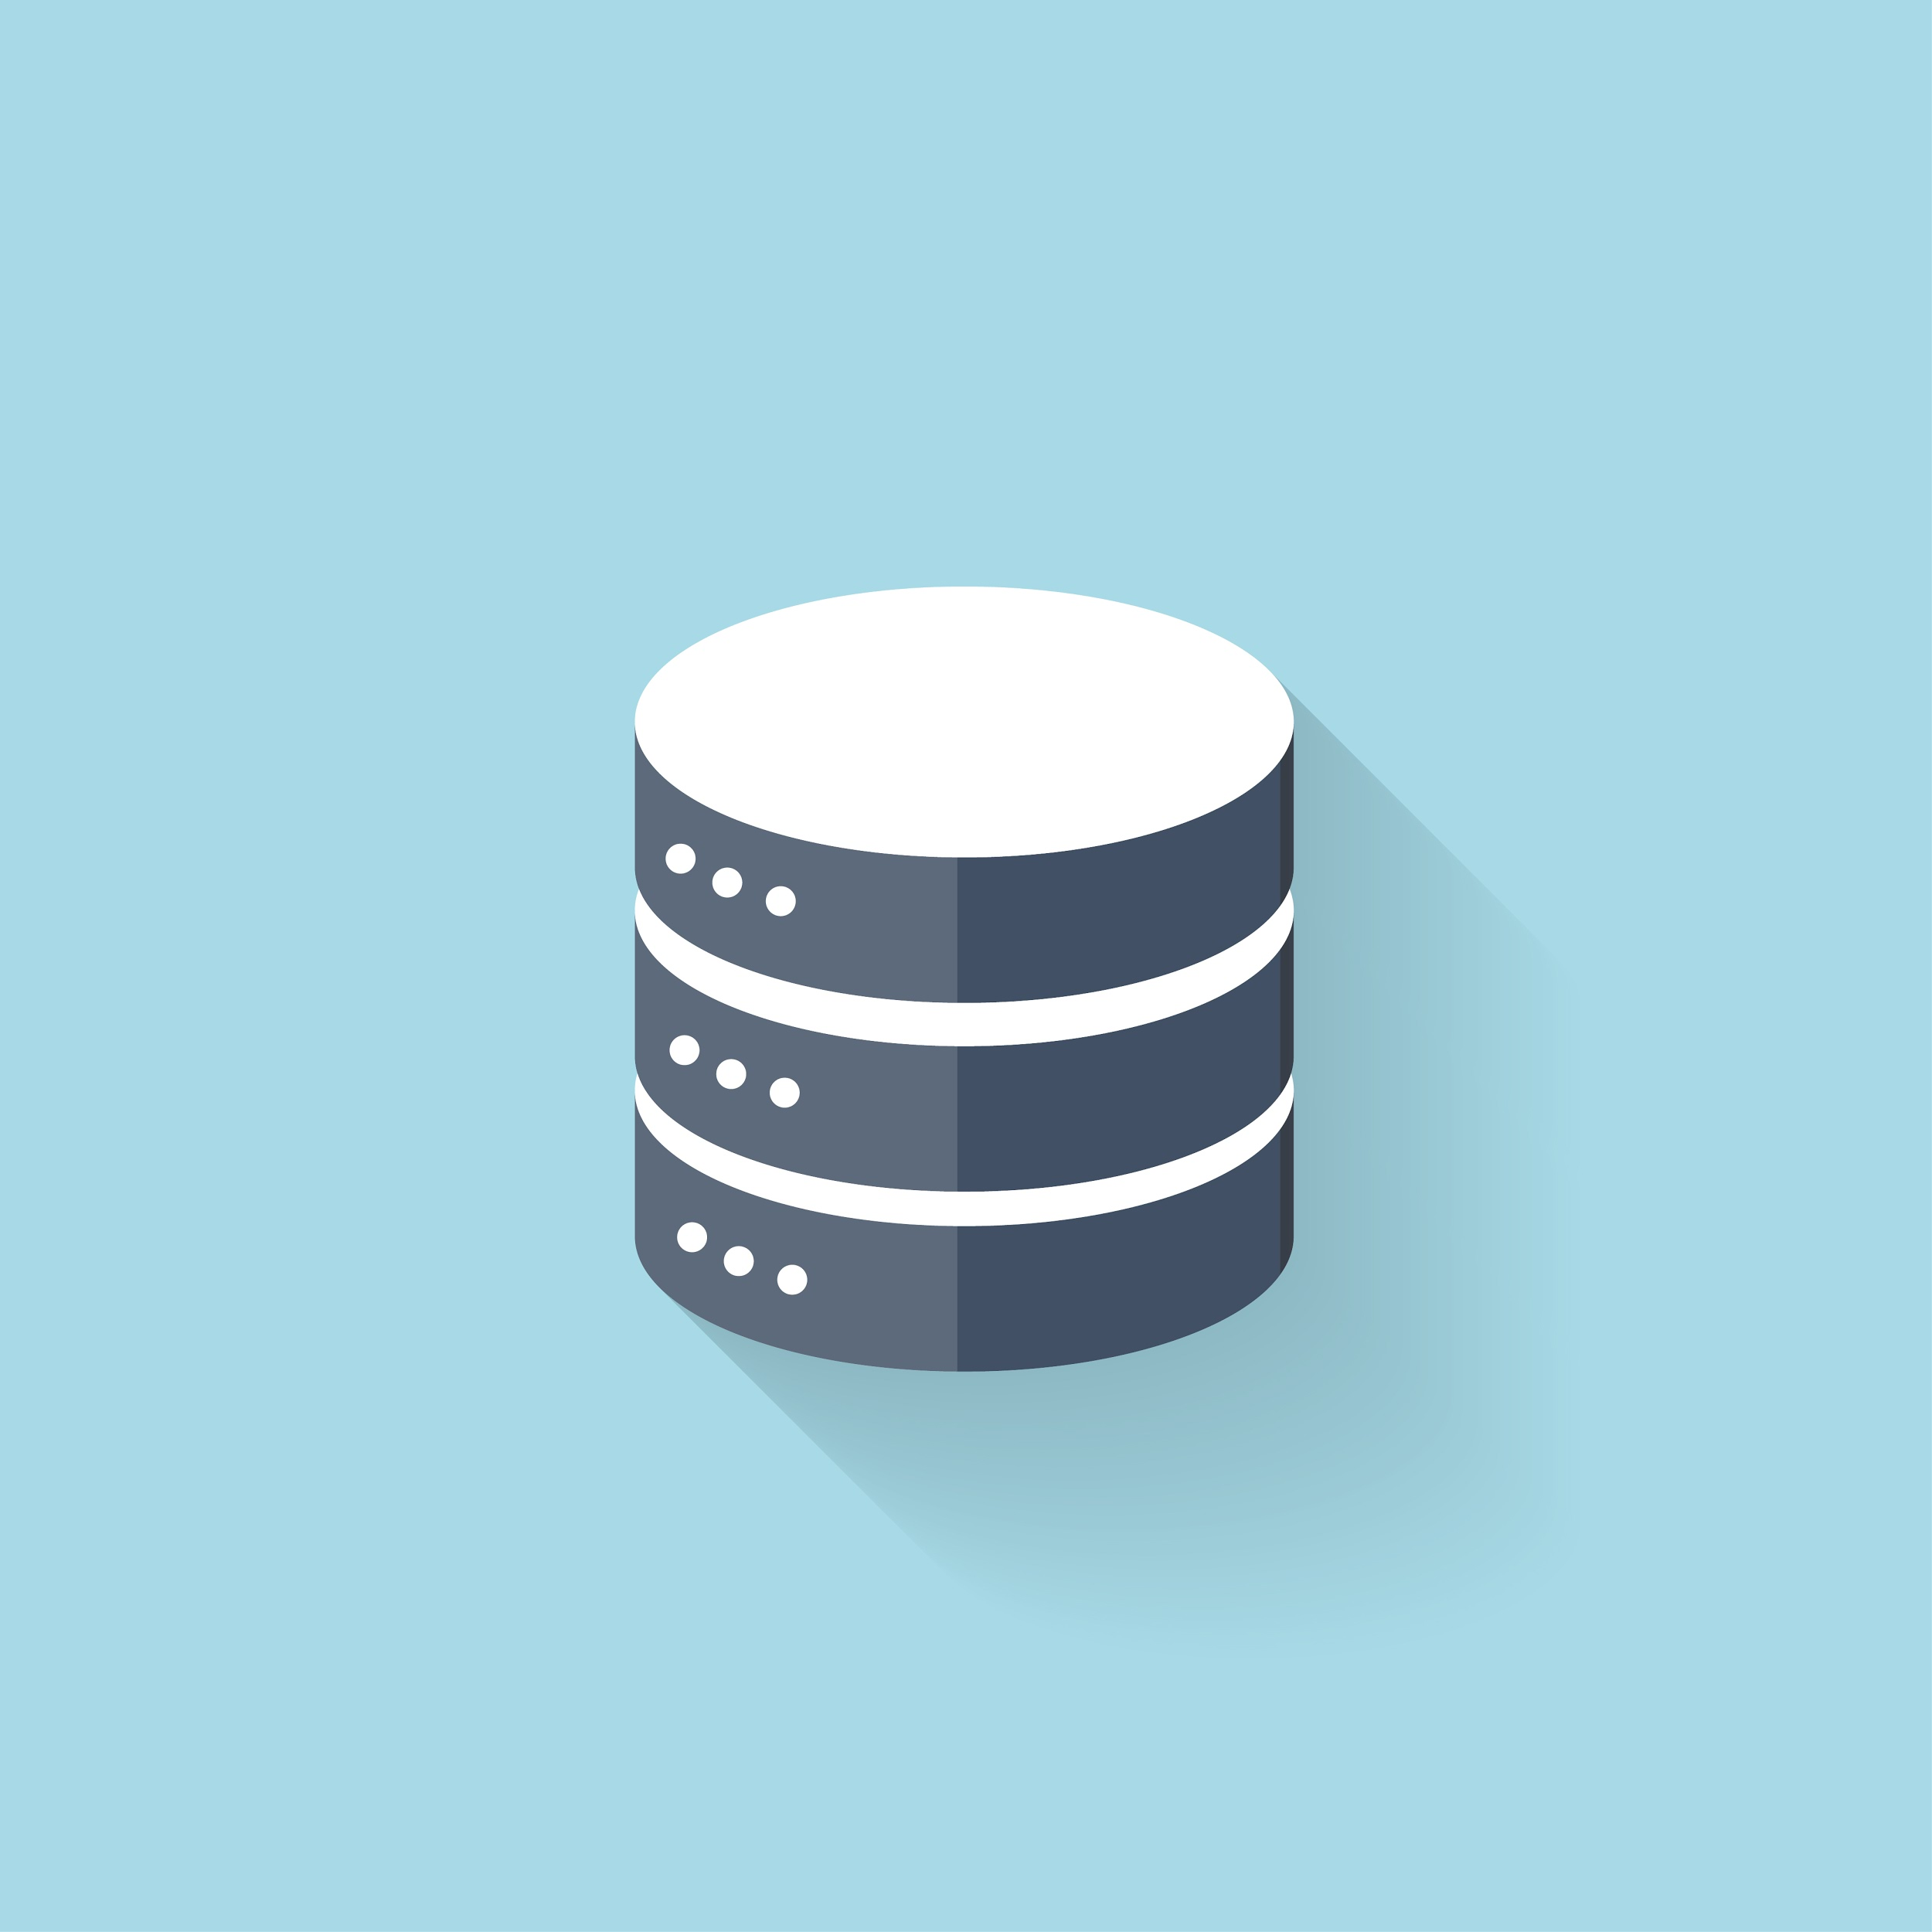
Introduction to MVC architecture
A model represents the data of a web application. The data is stored in the form of a model object and passed to the view by the controller.

Slide 7
Introduction to MVC architecture
Model directly manages the data, logic and rules of the application.
It is independent of the user interface which appears to the client.
For example, your friend suggestions, notifications, etc. will be stored as a model object and sent to the view by the controller class.

Slide 8
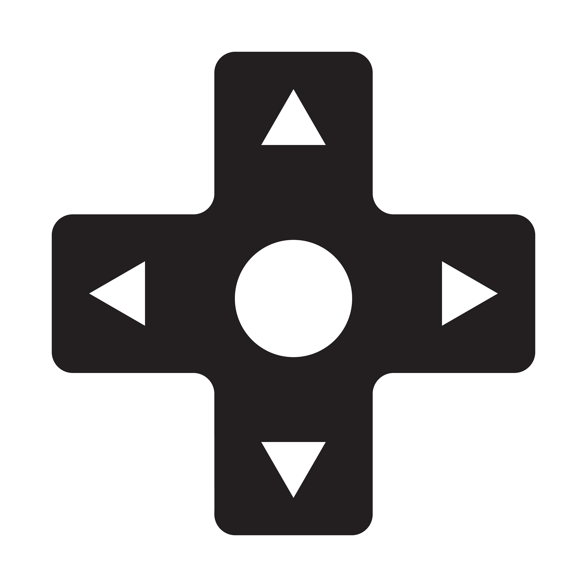
Introduction to MVC architecture
A controller involves classes and methods that process the business logic for you.
It is the main thinking agent in MVC architecture & is responsible for sending commands to the Model and View.

Slide 9
Introduction to MVC architecture
Controller receives a user request, processes it, and uses the model and view components to send the appropriate response to the user.
For example, in the Facebook newsfeed of a particular user, the controller would process all the relevant posts to display on the news feed, friend suggestions, notifications, etc.
It would then return all this information to the view.

Slide 10
Introduction to MVC architecture
The view component of the web application takes information from the controller (in the form of a model) and renders it on the web page to be displayed to the user.
Note that multiple views of the same data may be possible.

Slide 11

Introduction to MVC architecture
For example, the view would ensure that your notifications are visible at the top-right corner of the webpage and in a particular fashion (the font, colour, etc.).
The actual content of the notifications will be sent to the view by the controller.

Slide 12
Introduction to MVC architecture
So how exactly is MVC architecture implemented in websites?
Let us see MVC implementation of a previous example

Slide 13
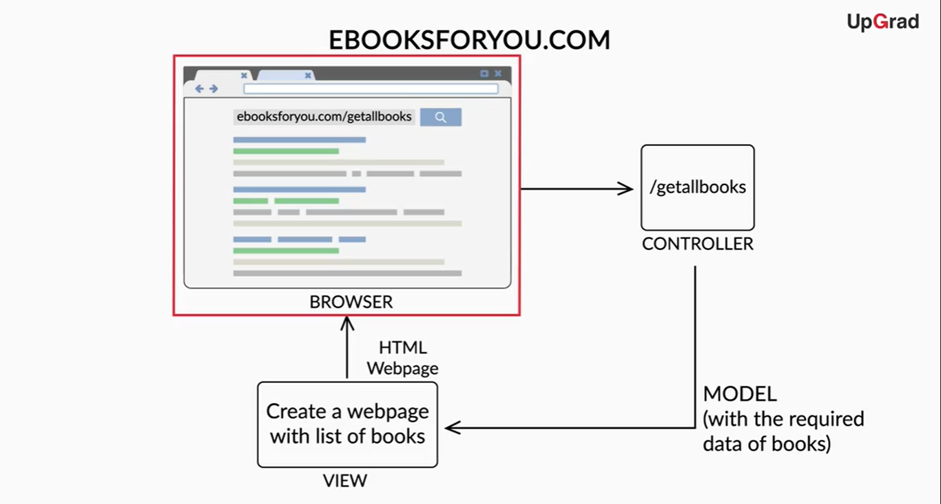
Introduction to MVC architecture

Slide 14
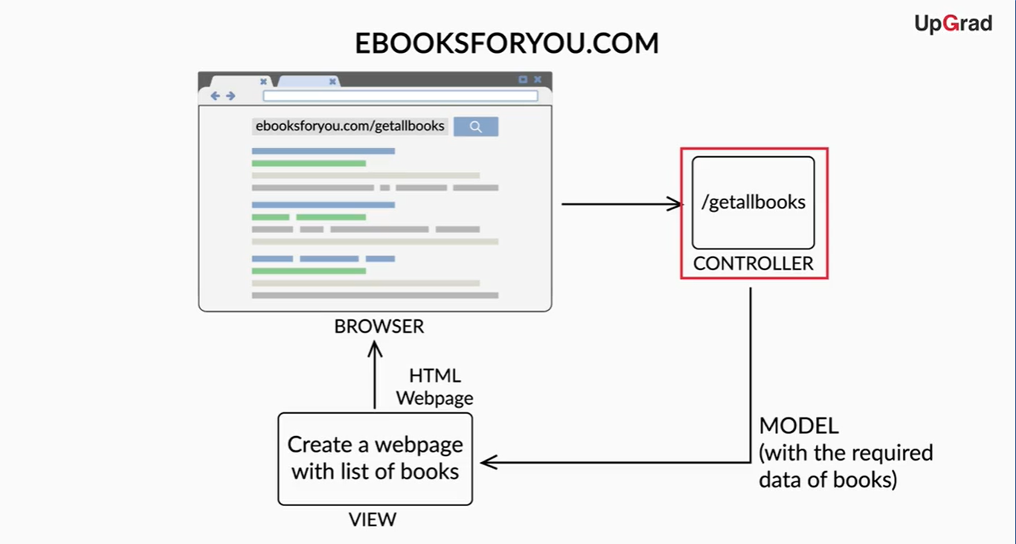
Introduction to MVC architecture

Slide 15
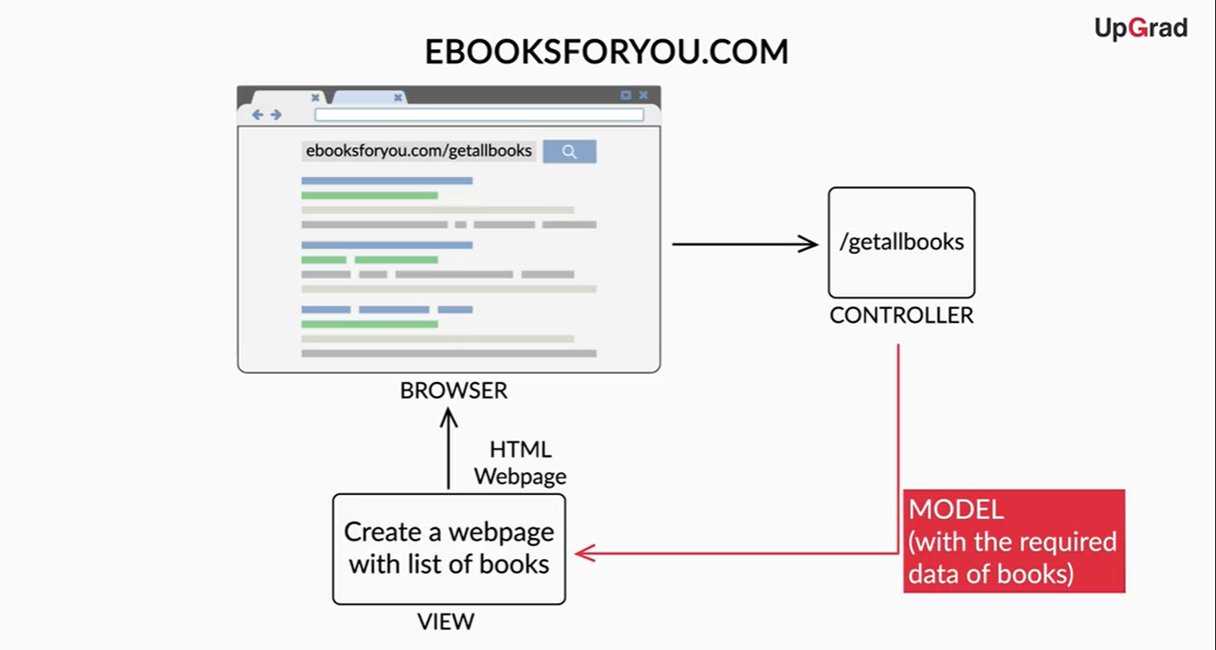
Introduction to MVC architecture

Slide 16
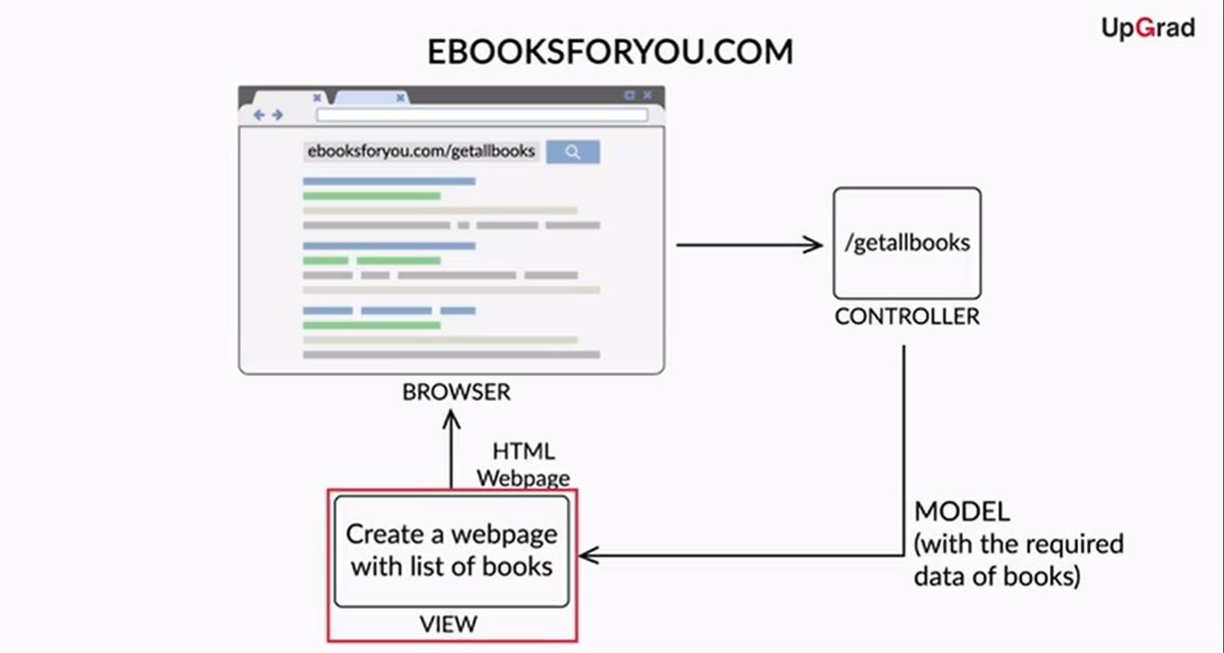
Introduction to MVC architecture

Slide 17
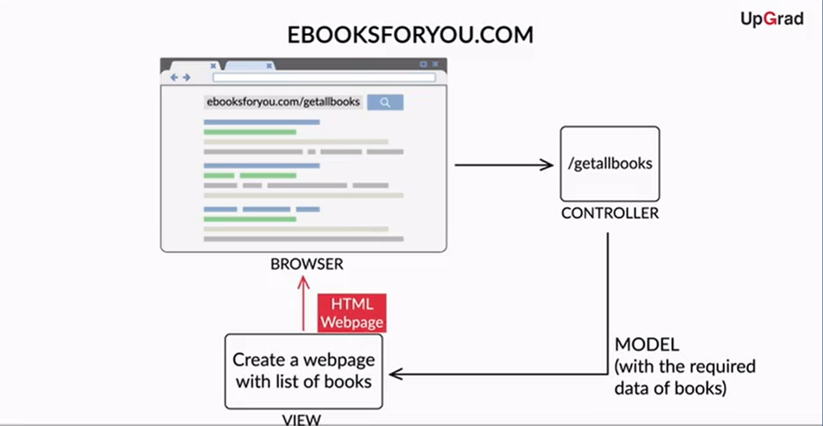
Introduction to MVC architecture

Slide 18
Introduction to MVC architecture
You can clearly see now that the separation of concerns is being handled well here.
Unlike servlets, the front-end (the HTML code), the back-end (the Java code), and the data are being handled by different components.
This means that:
the view part handles the front end,
the controllers handle the back end,
the model component is used to exchange data between the view and controller components.

Slide 19
Spring MVC
Now that you have gained an understanding of the theory related to the MVC architecture, let's move on to the implementation of the same using Java.
There are frameworks that provide us with pre-written code as JARs and guidelines to implement the MVC architecture, using Java to create a web application.
One of such frameworks is the Spring MVC

Slide 20
Spring MVC
SpringMVC provides us with a popular Java implementation of the MVC architecture to help develop web applications using MVC architecture.
It comes with a pre-written MVC framework that implements the underlying details of creating a website or web application.
This leaves the developer with only the task of writing the models, views, and controllers.
Let's understand what SpringMVC is and how it implements the MVC architecture.

Slide 21
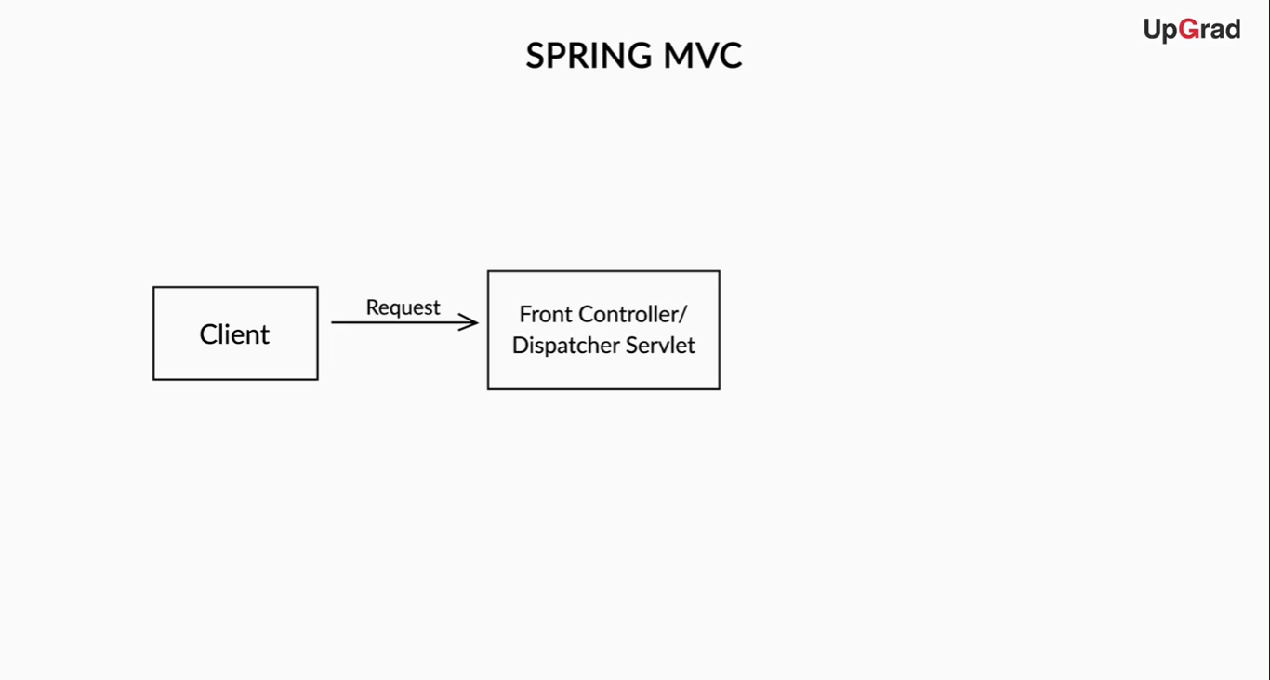
Spring MVC

Slide 22
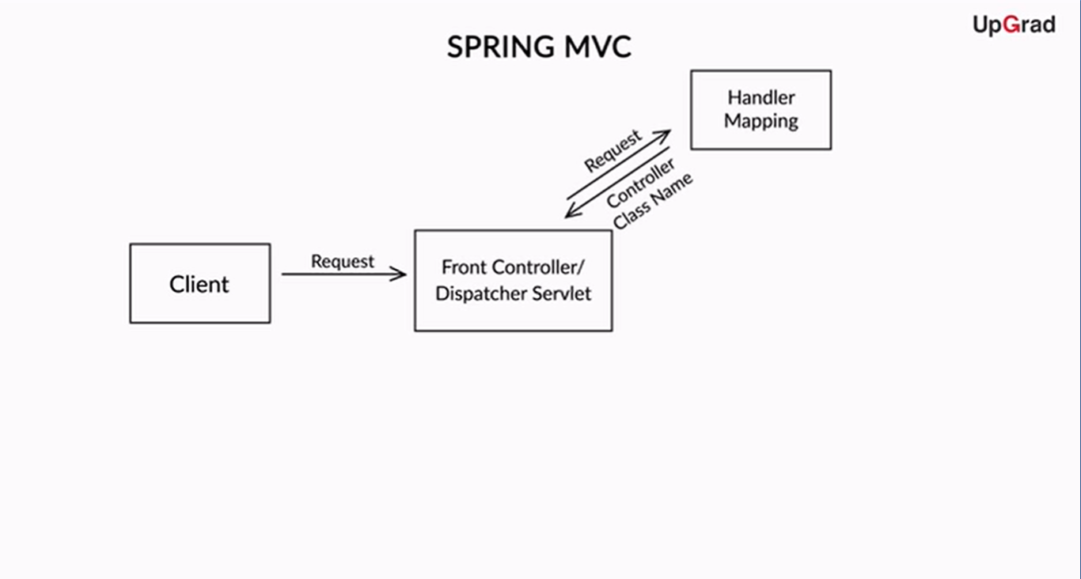
Spring MVC

Slide 23
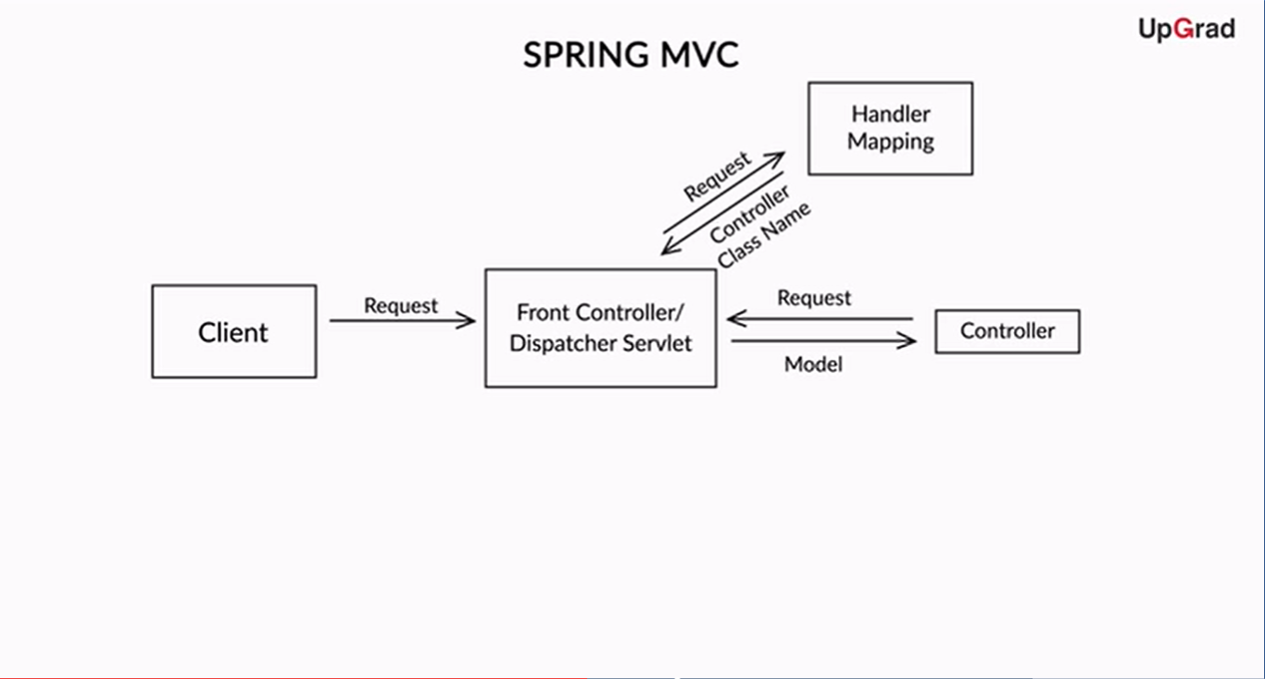
Spring MVC

Slide 24
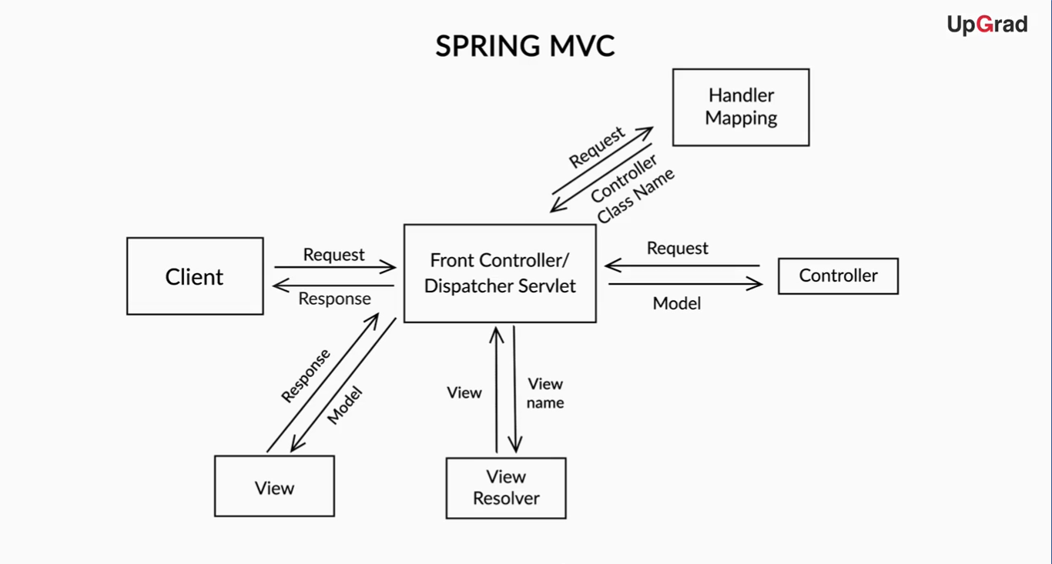
Spring MVC

Slide 25
Spring MVC
You saw that Spring MVC implements the MVC architecture through following components:
Dispatcher servlet
Handler mapping
View resolver

Slide 26
Spring MVC
Dispatcher servlet
This acts as a front controller.
This means that a request coming to the server is first intercepted and responded to by the dispatcher servlet.
The dispatcher servlet acts as a point of communication between all the other components.

Slide 27
Spring MVC
Handler mapping
When the dispatcher servlet receives a request, it contacts the handler mapping to get the name of the appropriate controller to which the request should be routed.
As you already learnt, there can be different controllers for different purposes, such as getting posts for your news feed and getting friend suggestions for you.

Slide 28
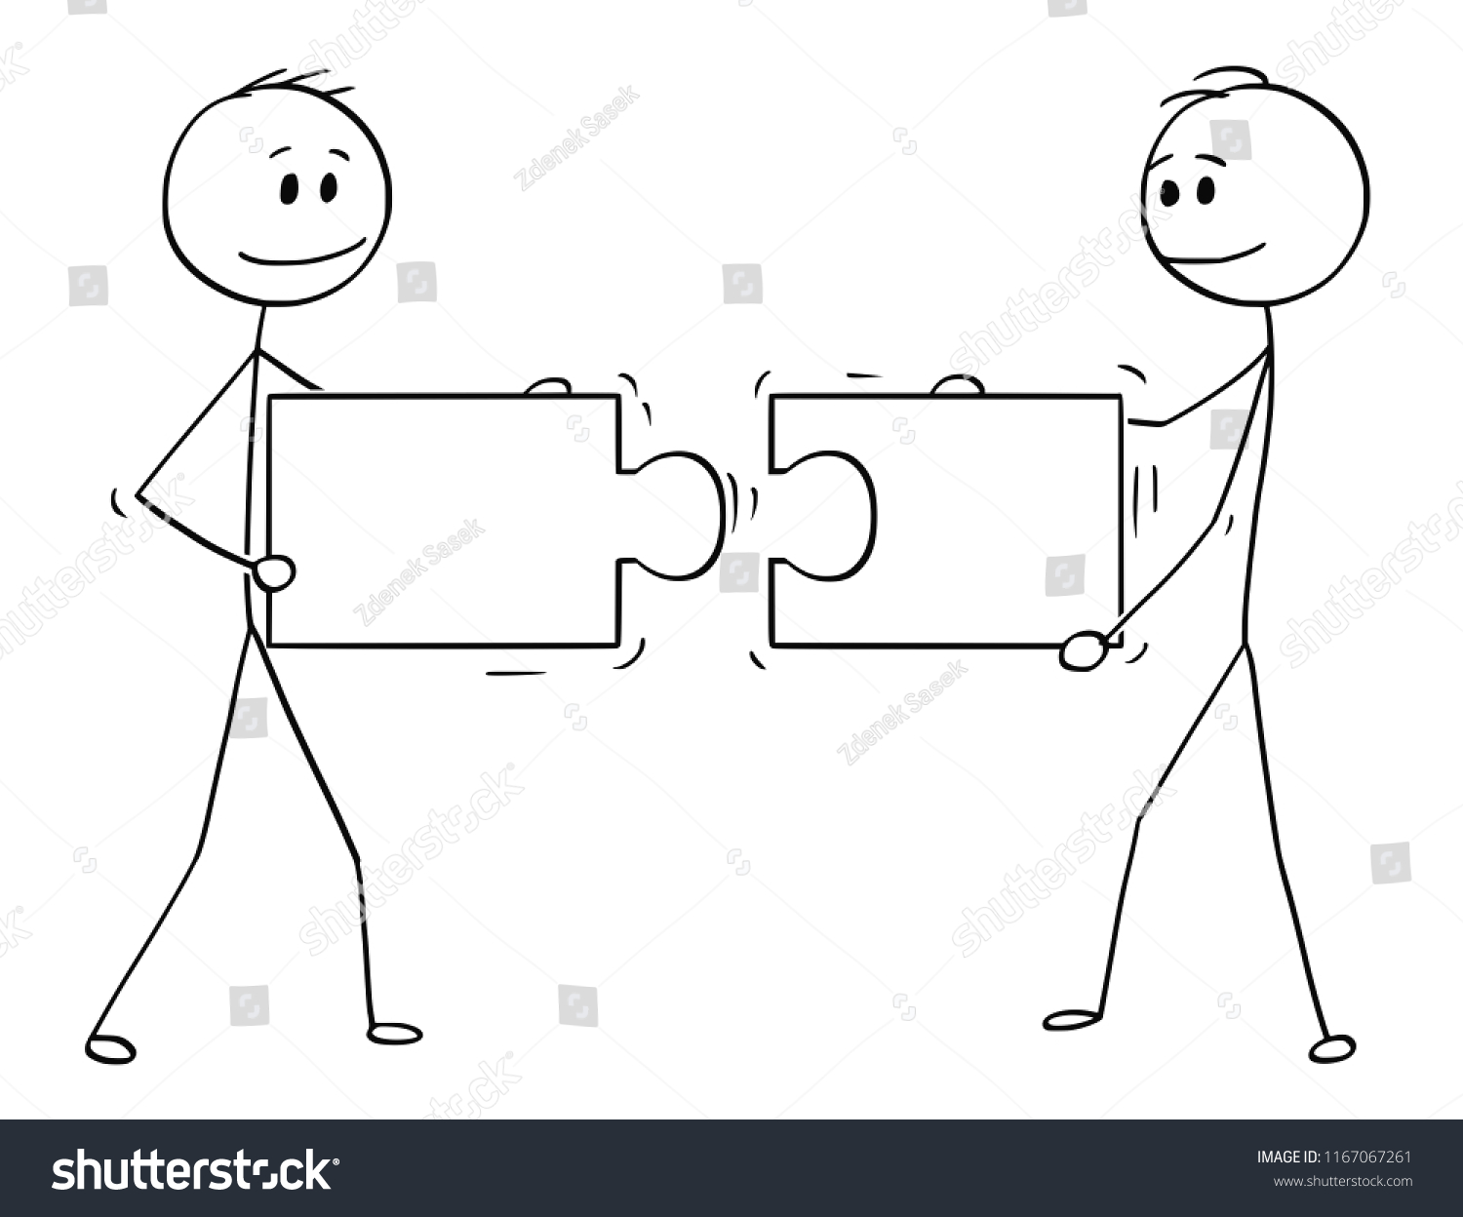
Spring MVC
Handler mapping
Handler mapping finds the right controller to be contacted and sends that information to the dispatcher servlet.
ID: 1167067261

Slide 29
Spring MVC
Controller
A controller is contacted by the dispatcher servlet to process a request.
It processes the client request, retrieves the required data or the model
It then sends this model along with the view name that the model has to be rendered to the dispatcher servlet.

Slide 30
Spring MVC
Model
The model represents the data layer of the website.
All the required data is stored in the database and sent from one component to another in the form of models.
Models are basically Java classes with specific attributes.

Slide 31
Spring MVC
Model
For example, a model class storing data about a student in a school would have attributes such as name, ID number, date of birth, etc.
The model layer also implements functionalities for the controller to retrieve and manipulate data in the database.

Slide 32
Spring MVC
View resolver
A view resolver receives the view name from the controller via the dispatcher servlet.
It has the mapping of view names and views.
It finds the appropriate view and sends it to the dispatcher servlet.
For example, the view name could be helloworld and the view could be helloworld.jsp. The view resolver would receive helloworld and return the view helloworld.jsp to the dispatcher servlet.

Slide 33
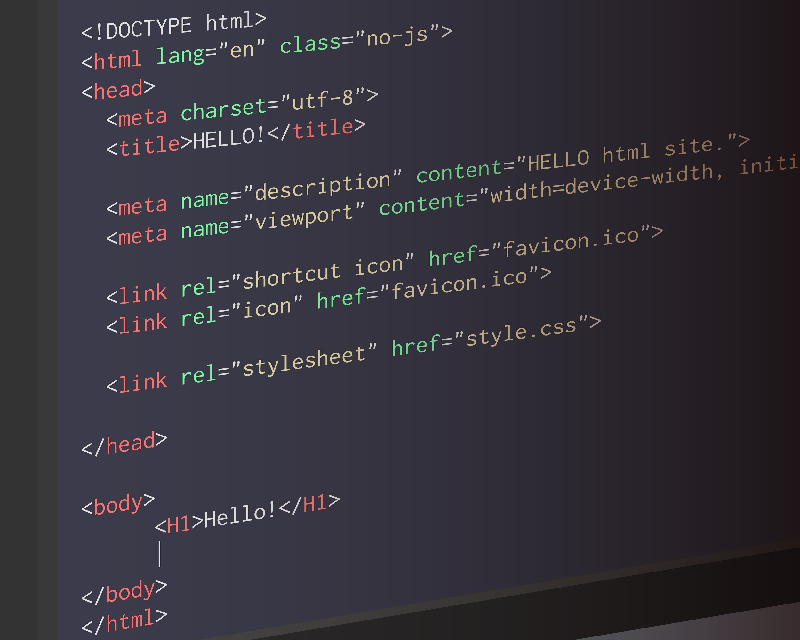
Spring MVC
View
The view receives the business logic and/or the model data from the controller via the dispatcher servlet and builds the HTML around the data that it receives.

Slide 34
Spring MVC
View
It builds the final web page that a client will be able to see.
It sends the HTML code back to the dispatcher servlet, which then sends the same to the client as a response.

Slide 35
Spring IOC container
An important core concept required to understand Spring MVC is the Spring IOC container, which plays a vital role in managing all the components of your web application.
The IOC container “registers” or keeps track of all the classes in your application, which are components of Spring MVC, such as the controller.
It creates an object of each of these classes to be used when required.

Slide 36
HelloWorld using Spring MVC
You have come across three annotations here:
@Controller
This annotation tells Spring that the class is a controller class.
@RequestMapping
This annotation is used to tell the Spring (dispatcher servlet and handler mapping classes) that the controller method is mapped to a specific URL.
@ResponseBody
It denotes that the object returned by this method is to be returned to the user as an HTTP response.

Slide 37
HelloWorld using Spring MVC
So far, you have learnt how to return the simple plain text from the controller class.
Now you will learn how to create an HTML page to the client using another dependency called Thymeleaf.

Slide 38
HelloWorld using Spring MVC
The Thymeleaf dependency is added to the POM.xml file.
Thymeleaf is a templating engine that allows you to write the view using HTML and also provides you with a view resolver.
Code example : https://github.com/Allah-The-Dev/java-spring-boot/tree/main/helloworld_servlet_jsp_spring

Slide 39


Thank you!
#LifeKoKaroLift

